Slide 1

Unit 3: Culture spot 3
New Zealand musts

Slide 2
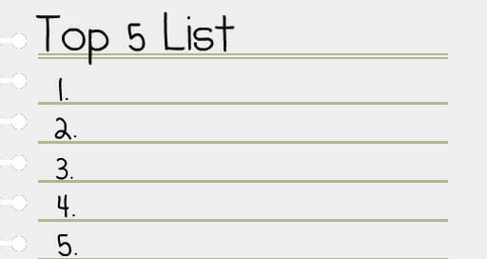
Task 1: How can you travel to New Zealand from Croatia? Is it far away?
Task 2: Read the text and make a top five list of New Zealand’s attractions you would like to visit.

Slide 3
Task 3: Read the text again. What have the Active Couch Potatoes already done and what is left for them to do in New Zealand?
They have already gone wild river rafting.
They have already explored filming locations.
They have already gone cycling.
They haven’t gone bungee jumping yet.
They haven’t gone flightseeing yet.
They have already gone kayaking.
They have already tried 'hangi'.
They haven’t tried whitebait fritters yet.
They haven’t tried kina yet.
They have already gone hiking in Rotorua.
They have already gone whale watching.

Slide 4
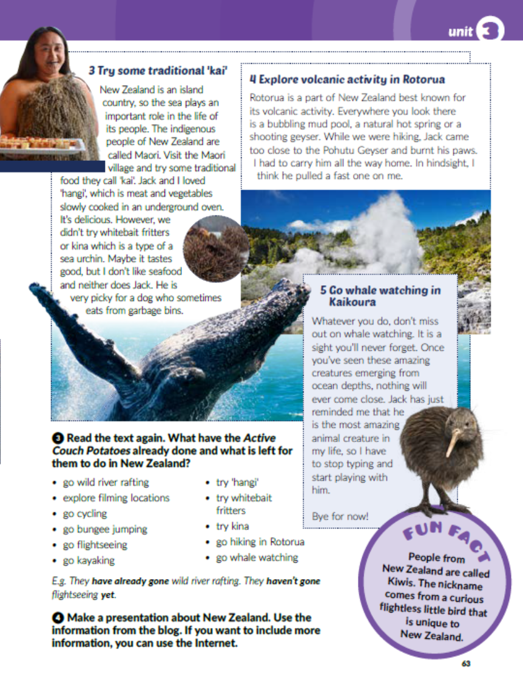
Task 4: Make a presentation about New Zealand. Use the information from the blog.
Use the Internet for pictures and more information.

Slide 5
Workbook, page 63
Task 1: Circle the correct answer.

Slide 6

PLAY AND LEARN!
https://www.e-sfera.hr/dodatni-digitalni-sadrzaji/5770ff71-90b6-4532-a791-b2fb10321b57/

